Slide 1
Evolution
Molecular evolution

Slide 2
DNA holds clues about genealogy and modes of evolution
DNA sequencing
Sequence alignment
Phylogenetic reconstruction
Molecular clocks
Signatures of natural selection

Slide 3
Coronavirus
How can we understand SARS-CoV-2, the virus causing COVID-19, from an evolutionary perspective?

Slide 4
Discussion questions
In relation to the R exercise
How do the origins of SARS-CoV-2 compare with the origins of seasonal and pandemic flu strains?
How could you apply SARS-CoV-2’s molecular clock to make inferences about disease spread early in the pandemic?
Why do you think is genetic variation not equally distributed across the virus genome?
How do you interpret the analyses of molecular evolution (w), and how do you expect these results to change if they were made based on data collected now and data collected a few years from now?
What questions do you have about SARS-CoV-2 evolution, exercise-related or not?
Before you get started:
Make sure to introduce each other
Choose a timekeeper
Choose a reporter
Breakout groups for 20 minutes

Slide 5
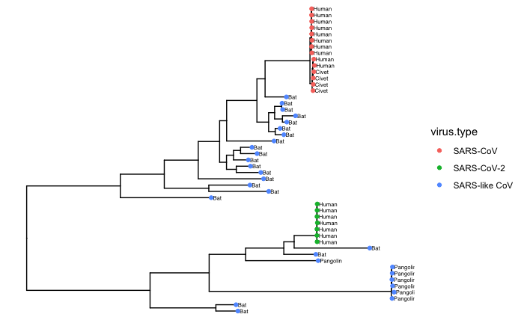
Decoding history

Slide 6
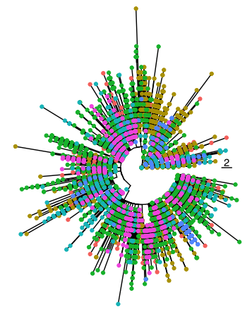
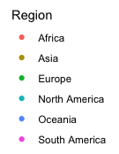
Decoding history
https://nextstrain.org/ncov/global

Slide 7
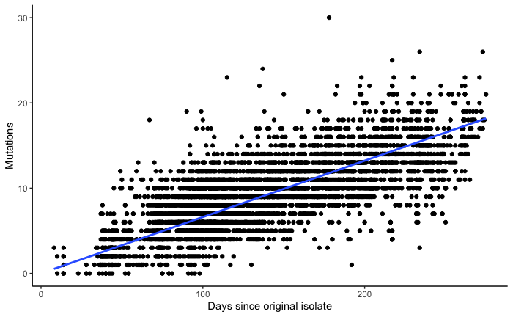
COVID’s molecular clock
~24 mutations per year

Slide 8
Coronavirus: how wide-spread is it?
USA/WA1/2020 was the first US case in a traveler directly returning from Wuhan (Jan 19); patient was isolated
USA/WA2/2020 was the first US case with no connection to China (Feb 29)
What does that mean?

Slide 9
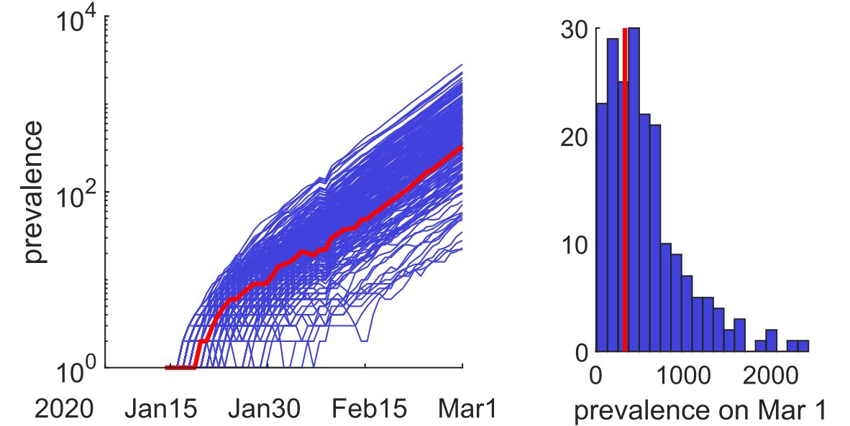
Coronavirus: how wide-spread is it?
USA/WA1/2020 was the first US case in a traveler directly returning from Wuhan (Jan 19); patient was isolated
USA/WA2/2020 was the first US case with no connection to China (Feb 29)
Cryptic transmission was likely widespread!
First confirmed COVID-death in Kansas was Jan 11!!!

Slide 10
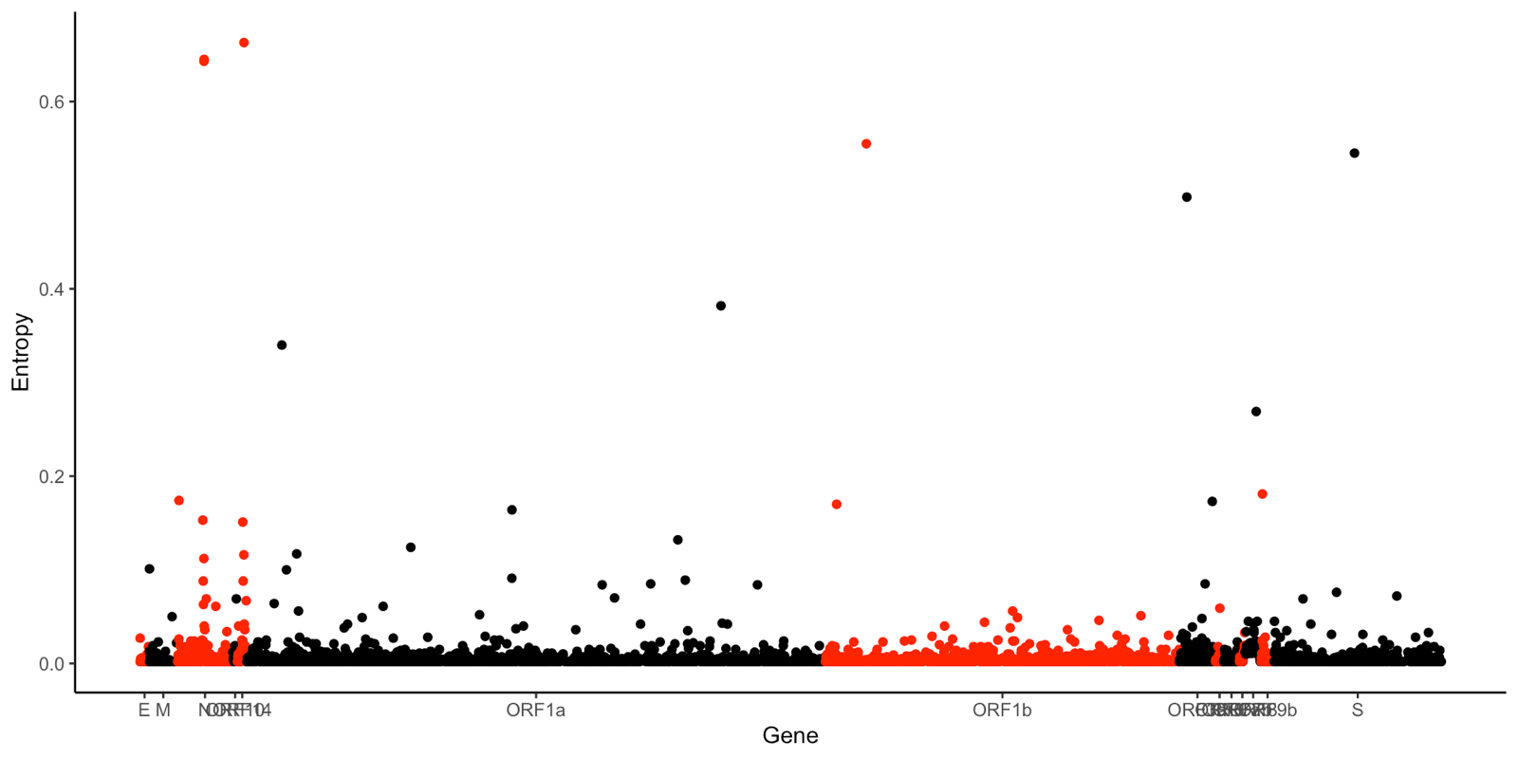
Coronavirus: where do mutations occur?
Mutations are pretty much randomly distributed across the genome
But there are some peaks!

Slide 11
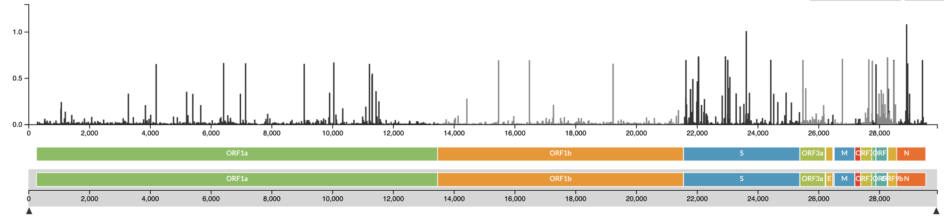
Coronavirus: where do mutations occur?
Mutations are pretty much randomly distributed across the genome
But there are some peaks!

Slide 12
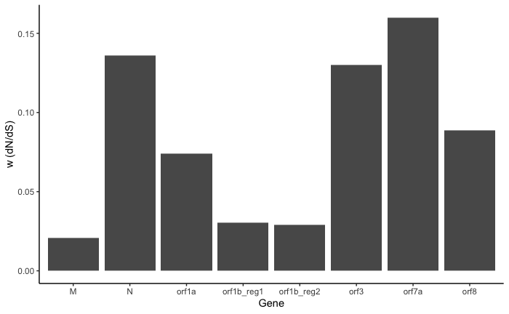
Coronavirus: where do mutations occur?
Is there evidence for positive selection?

Slide 13
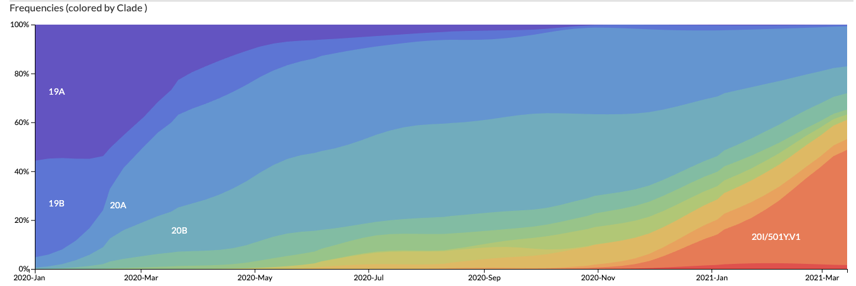
Coronavirus: where do mutations occur?
Is there evidence for positive selection?
No… but!
Little selection early in a pandemic!

Slide 14
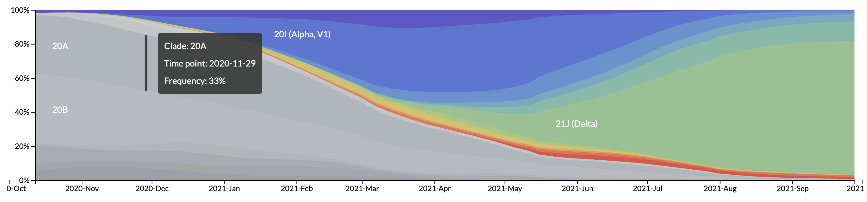
Coronavirus: where do mutations occur?
Is there evidence for positive selection?
No… but!
Little selection early in a pandemic!

Slide 15
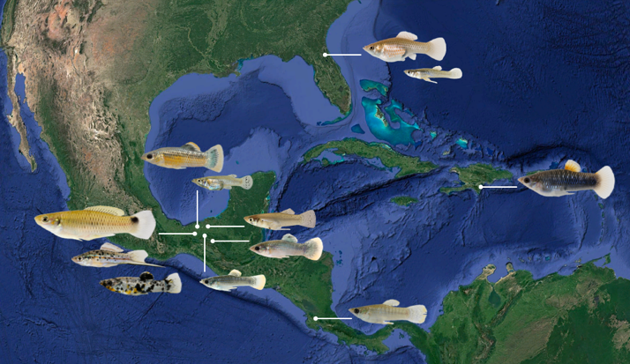
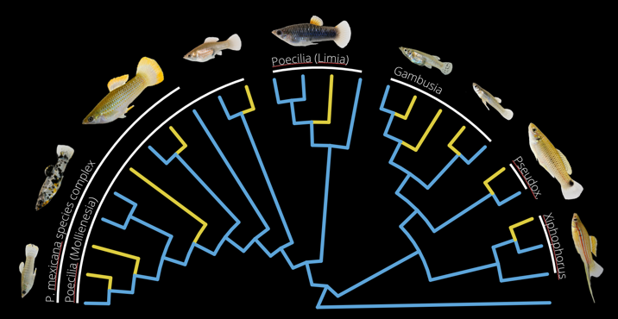
DNA holds clues about genealogy and modes of evolution
Phylogenetic reconstruction
Molecular clocks
Signatures of natural selection
COX-1
COX-3
26
64
75
122
128
453
40
88

Slide 16
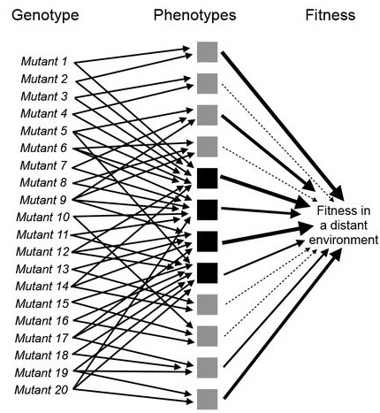
Genes to phenotype
There is not a gene for a trait
Most traits—and certainly organismal fitness—have a complex genetic basis
We do not need to know what genes underlie a quantitative trait to predict the evolution of that trait

